Slide 1
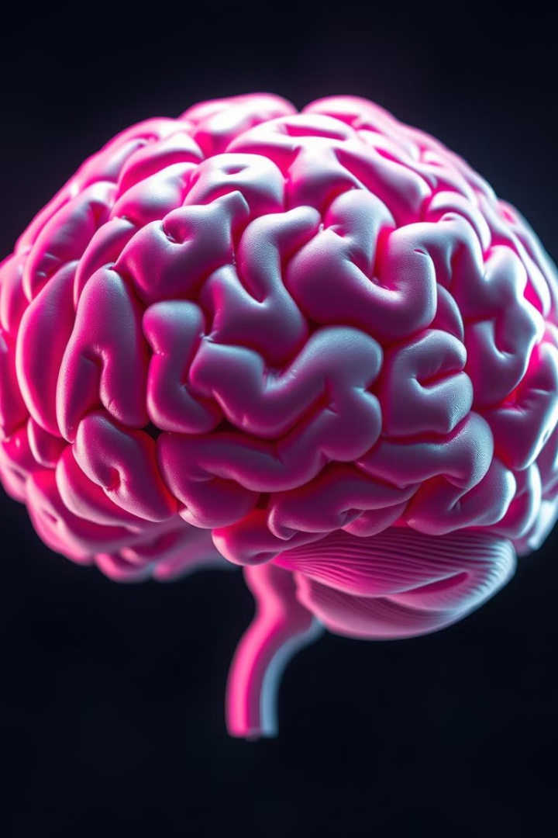
BIOLOGICAL BASIS OF BEHAVIOR-INTRODUCTION
This presentation explores the intricate relationship between the body and the mind, delving into the biological underpinnings of human behaviour.

Slide 2
Psychology studies human behaviour, which involves both the body and the mind. They are interrelated and interact upon each other. Mental functions and physical states affect each other.
Body and the mind are two aspects of the living, dynamic and adjusting personality.
Mind is the sum total of various mental processes such as observing, knowing, thinking, reasoning, feeling, imagining, remembering, judging etc.
Body is represented by physical states and bodily functions. Our nervous system and glands which are an important part of our body are responsible for our ways of thinking, feeling and doing.

Slide 3
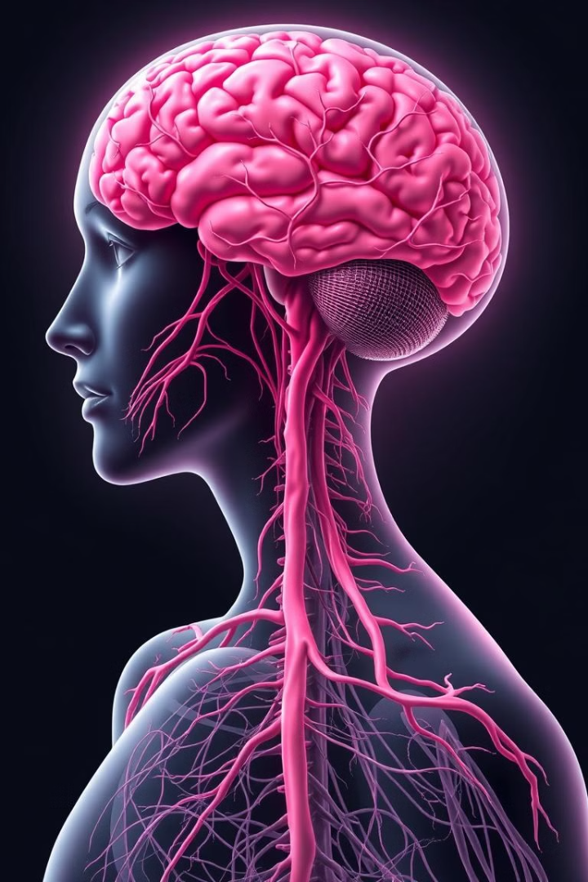
All behaviours have an anatomical and physiological basis. Physiological structures, body fluids, chemicals and mechanical events, all influence both our overt behaviour and our feelings and experiences.
Emotions are a combination of bodily responses and mental processes. Body provides energy to fight or cope, mind contributes to the understanding, to offer an explanation for one's own actions or actions of others.

Slide 4
EFFECTS OF BODILY CONDITIONS ON MENTAL FUNCTIONING
Increased blood pressure
Mental excitement
Severe pain
Reduced concentration level
Chronic illness
Depression
Malfunctioning of endocrine glands
Lethargy, nervous tension etc.
Physical fatigue
Mood changes, reduced motivation, interest and concentration
Brain injury
Affects many psychological functions

Slide 5
EFFECTS OF MENTAL CONDITIONS ON BODILY FUNCTIONING
1
2
3
Unpleasant emotions like fear, anger etc cause irritability, insomnia, headache etc.
Emotional conflicts are responsible for peptic ulcer, ulcerative colitis etc.
Deep thinking and concentration can cause physical strain.
4
Repressed feelings of dependency and wish to receive love affect parasympathetic nervous system resulting in gastrointestinal disorders and respiratory disorders.

Slide 6



Body-Mind Relationship and Health
Relationship
The relationship between body and mind has an effect on health and illness. If the relation is positive it leads to good health while an adverse relationship leads to illness.
Psychosomatic Medicine
Psychosomatic medicine deals with physical diseases caused by psychological factors. Here patients are given treatment for both mind and body.
Treatment
EG:-in case of peptic ulcer the treatment includes both by way of drugs and psychotherapy.

Slide 7
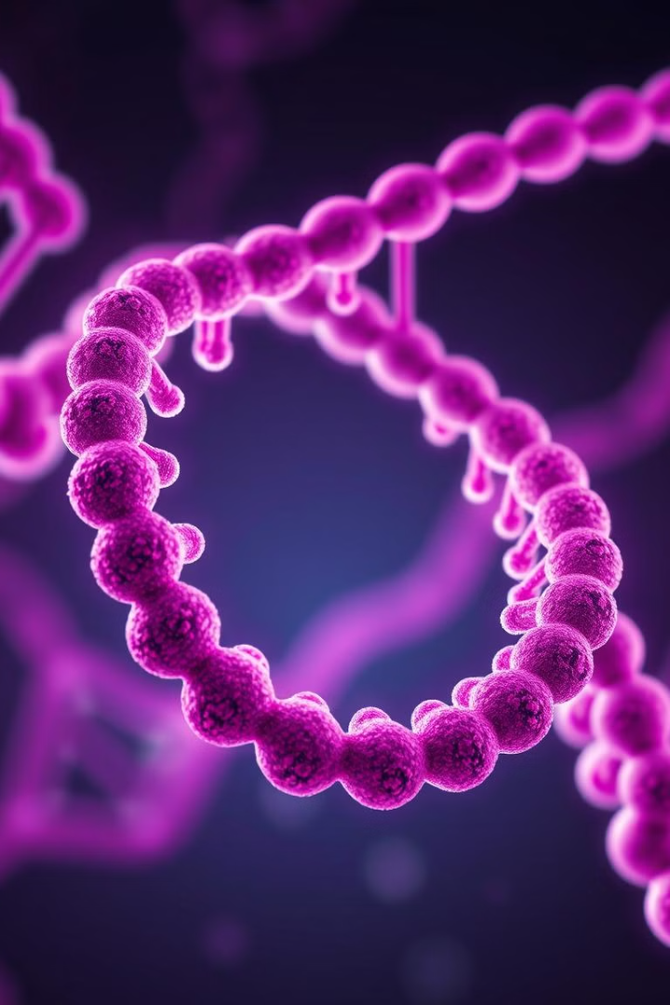




GENETICS AND BEHAVIOR
Gene
Genetics
Gene is the basic unit of heredity that get transferred from generation to generation through the immediate parents to their offspring.
Genetics is the mechanism of the transfer of hereditary characteristics in the form of genes, chromosomes and DNA.
Heredity
Study of Heredity
Heredity is considered as 'the sum total of inborn individual traits'.
The study of heredity is called genetics.

Slide 8
MECHANISM OF HEREDITY
Fusion of Sperm and Ovum
Genes
Chromosomes
The genes which are the carriers of distinctive traits are present both in the sperm and the ovum.
In the fertilized ovum there are 23 pairs of chromosomes, half of which are given by the father and the other half by the mother.
The life cycle of an individual begins with the fusion of a sperm and ovum. When a sperm unites with an ovum, zygote is produced.
Sex Chromosomes
While females have 23 pairs of XX chromosomes, males have 22 pairs of XX chromosomes and two single chromosomes represented by X and Y.

Slide 9
Sex-Linked Characteristics
Colour Blindness
Mutations
EG:-Colour blindness. The sons of a colour blind man and normal woman do not inherit the defect, but daughters may be carriers of the disorder to another generation of males, their sons.
Changes occur in the reproductive cells of a living thing which causes the introduction of completely new traits in the next generations. Such changes are called mutations.
Some characteristics are sex linked, i.e. one sex shows the characteristics while the other sex not apparently affected is the carrier.

Slide 10



Heredity is the basis for development of human personality.
The child inherits the traits and characteristics of his parents and forefathers through genes at the time of conception.
Genetic factors have been found responsible for causing cognitive malfunctioning and mental deficiency among children.

Slide 11
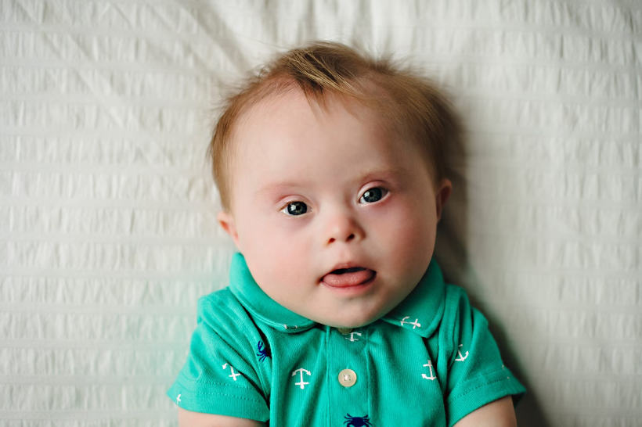
Eg:-Down syndrome is a genetic disorder that occurs when a person has an extra or partial copy of chromosome 21. This extra genetic material changes how the body and brain develop, leading to physical and mental challenges.

Slide 12
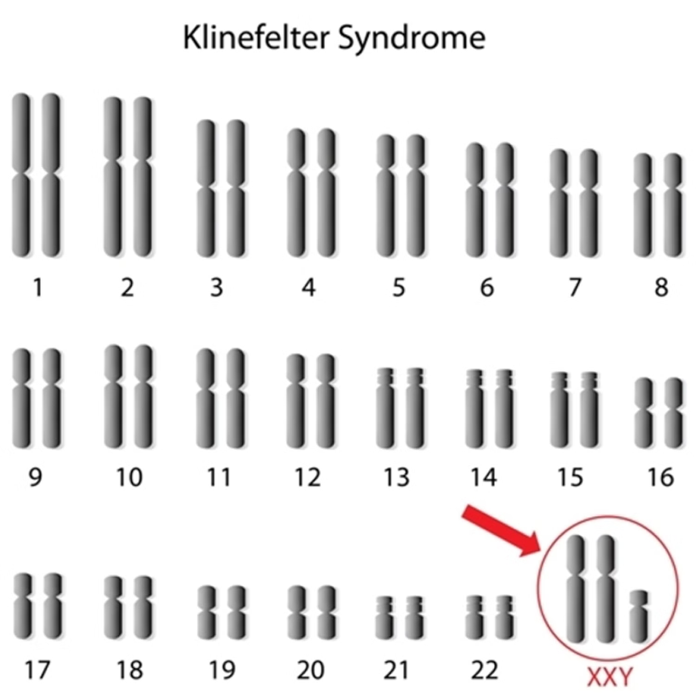
Klinefelter's syndrome is a chromosomal abnormality that occurs in males, caused by the presence of an extra X chromosome.

Slide 13
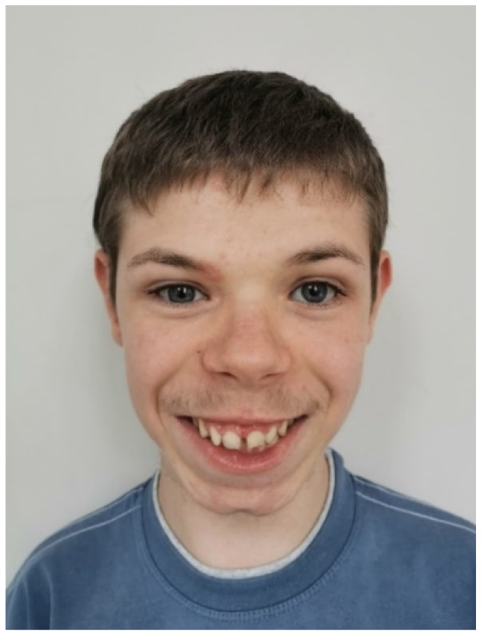
Phenylketonuria is a genetic disorder caused by defective recessive genes that disrupt metabolism.

Slide 14
Learning disabilities and behavioural disorders-genetic or hereditary factors have been found responsible for causing learning disabilities and behavioural disorders.
The most severe cases of emotional disturbances like schizophrenia has been found to be linked with genetic factors.

Slide 15
BRAIN AND BEHAVIOUR
Brain is responsible for eliciting responses to stimuli.
Eg:-An individual sees a snake at a distance . This snake works here as a stimulus .The visual sensory experience of the snake is received by receptor organ, eye . The reaction may be attacking or fleeing . Here fear or attack response are generated through emotional reactions from secretion of some glands(adrenal).
The entire behaviour is managed and controlled by the coordination and functioning of nervous system.
The proper growth and development of nervous tissues and nervous system as a whole helps in the task of proper intellectual developments.

Slide 16
Any defect in the spinal cord or brain seriously affects the intellectual growth.
During emotional outburst nerve tissues cause the change in the secretion of hormones by some glands and consequently influence the emotional behaviour of an individual.
The personality of an individual is influenced through the mechanism of the nervous system.
Human behaviour involves the body-mind interaction of the various bodily factors . the most important are:
1)The sense organs called receptors
2)The muscles and endocrine glans called effectors
3)The nervous system known as the connecting mechanism.

Slide 17
RECEPTORS
Behaviour in all in forms has a biological base. The behaviour is based on various stimuli present in the external environment and lying within our body.
The stimuli in the form of various sensory experiences are received by our sensory organs known as receptors.
EXTERNAL RECEPTORS
External receptors are those sensory mechanisms that help us make contact with the outer world.
Eg: - eyes, ears ,nose , tongue and skin.

Slide 18
Sense organs:-
Sense organs helps in assimilating knowledge of the world around us.
Sense organs consist of receptors which are specialized sensitive cells associated with endings of sensory nervefiber.
When the receptors are not functioning properly they lead to sensory defects- visual, auditory , cutaneous , olfactory , gustatory and kinesthetic disorders.
INTERNAL RECEPTORS
Internal receptors are associated with the internal stimuli present in our body.
They are responsible for feelings of pain, hunger or nausea.
It helps us in maintaining balance, bodily posture and equilibrium.

Slide 19
EFFECTORS
Effectors are termed as the organs of receptors.
What is received through the sensory organs in the form of sensory input is responded through the bodily reactions and motor activities carried out through muscles and glands particularly the hormones secreted by the ductless glands which are responsible for most of our behaviour patterns.
The under activity or over activity of these glands causes deficiency or excess of hormonal secretion . this affects the entire personality of an individual.

Slide 20
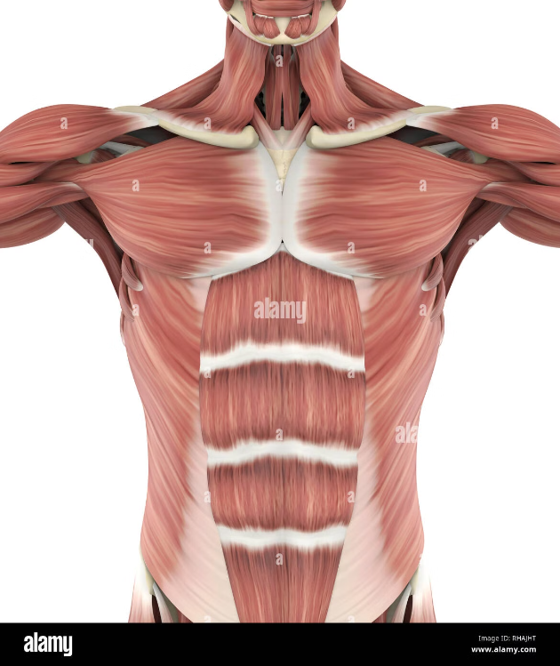
MUSCLES
Our behaviour and activity involves movement of different parts of our body . muscles helps to carry out motor activities in order to respond to various stimuli.
1)Smooth muscles-concerned with digestion, excretion and blood circulation . their contraction or relaxation cause constriction or dilation of blood vessels thus increasing or decreasing blood pressure.
2)Cardiac muscles-when one is emotionally upset their normal functioning disturbed causing heart attack.
3)Skeletal muscles-enable the individual to perform voluntary motor activities.

Slide 21
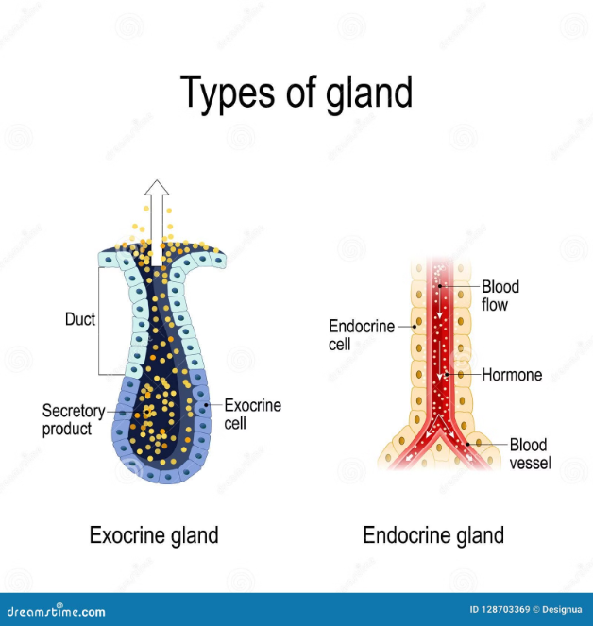
GLANDS
Glands play an important role in human behaviour.
They assist in digestion , elimination of waste products , production and prolongation of emotional states and regulation of metabolism of body.
1)Duct glands or exocrine glands-release their chemical secretion through little ducts in the body.
Eg:-salivary glands, sweat glands, kidneys etc.
2)Ductless or endocrine glands-secrete chemical substance called hormones . the hormones are released to blood and carried to all parts of the body.
Eg:-pituitary gland, thyroid and parathyroid gland, adrenal glands etc.
They play a vital role in the determination of human personality.

Slide 22
The functioning of all endocrine glands have a great influence on various aspects of growth and development of human behaviour.
The slight imbalance of hormones cause unusual restlessness, anxiety and weakness.
CONNECTORS
Connectors help in regulating the activities of receptors and effectors.
NEURON-A nerve cell with all its branches is called neuron.
SYNAPSE-Information is transmitted through the body from one neuron to another . the junction between two neurons is called synapse.

Slide 23
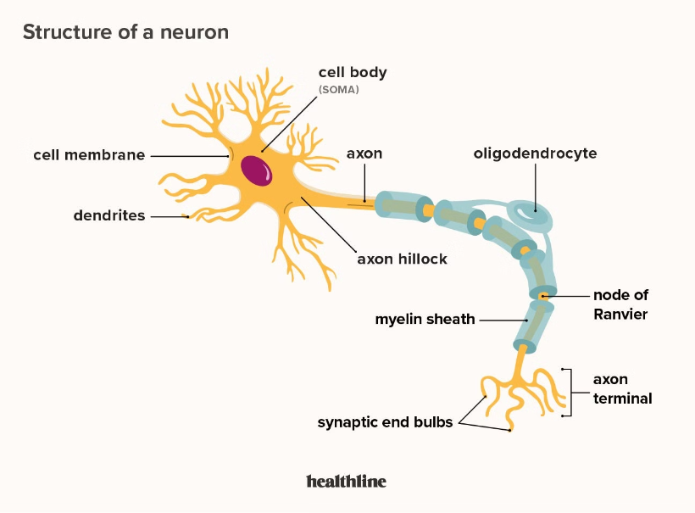
NERVOUS SYSTEM-The nervous system is the master controlling , communicating and regulatory system in the body.
It is divided in to central nervous system(CNS) and peripheral nervous system(PNS).
CNS consists of brain and spinal cord which act as the commanding centres of the nervous system.

Slide 24
